Slide 1
Shiny - Part 1

Slide 2
Shiny App – Skeleton

Slide 3
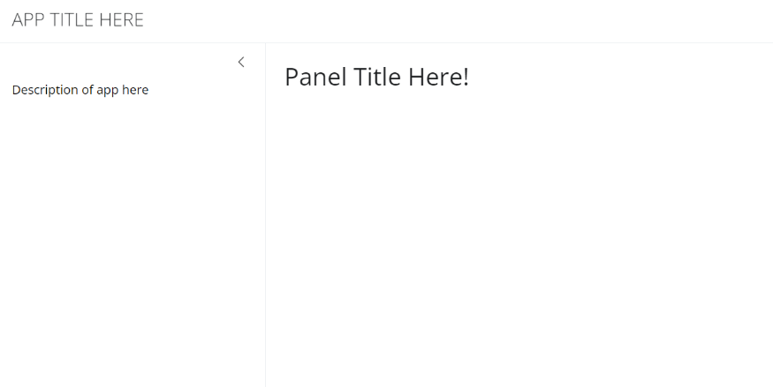
library(shiny)
library(bslib)
# Define user interface
ui <- page_sidebar(
# App title
title = "APP TITLE HERE",
# Sidebar
sidebar = sidebar(
width = 350,
"Description of app here",
# Widget code here
),

Slide 4
# Main Panel
titlePanel("Panel Title Here!"),
)
# Define server logic
server <- function(input, output) {
}
# Run the app
shinyApp(ui = ui, server = server)

Slide 5
Widgets

Slide 6
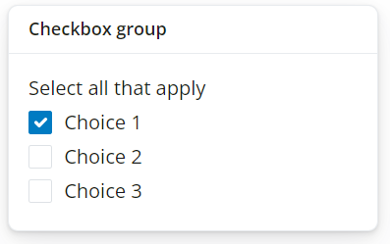
Checkbox Group
Codes:
card(
card_header("Checkbox group"),
checkboxGroupInput(
inputId = "checkGroup",
label = "Select all that apply",
choices = list("Choice 1" = 1, "Choice 2" = 2, "Choice 3" = 3),
selected = 1)
),

Slide 7
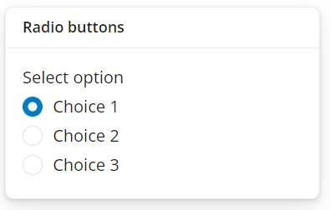
Radio Buttons
Codes:
card(
card_header("Radio buttons"),
radioButtons(
inputId = "radio",
label = "Select option",
choices = list("Choice 1" = 1, "Choice 2" = 2, "Choice 3" = 3),
selected = 1)
),

Slide 8
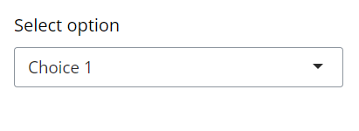
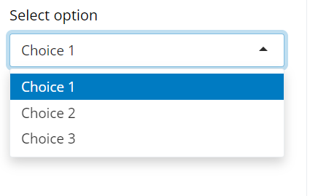
Select Box
Codes:
selectInput(
inputId = "select",
label = "Select option",
choices = list("Choice 1" = 1, "Choice 2" = 2, "Choice 3" = 3),
selected = 1),

Slide 9
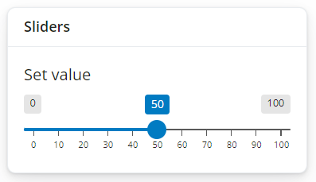
Sliders
Codes:
card(
card_header("Sliders"),
sliderInput(
inputId = "slider",
label = "Set value",
min = 0,
max = 100,
value = 50)
),

Slide 10
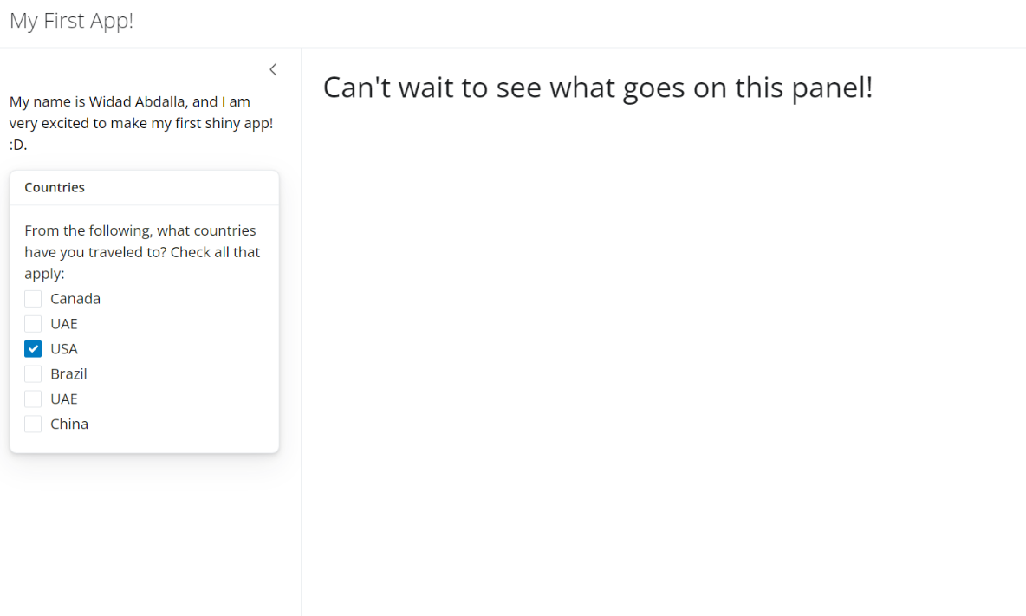
To Recreate 1
File Name: shiny_app_widget_checkbox

Slide 11
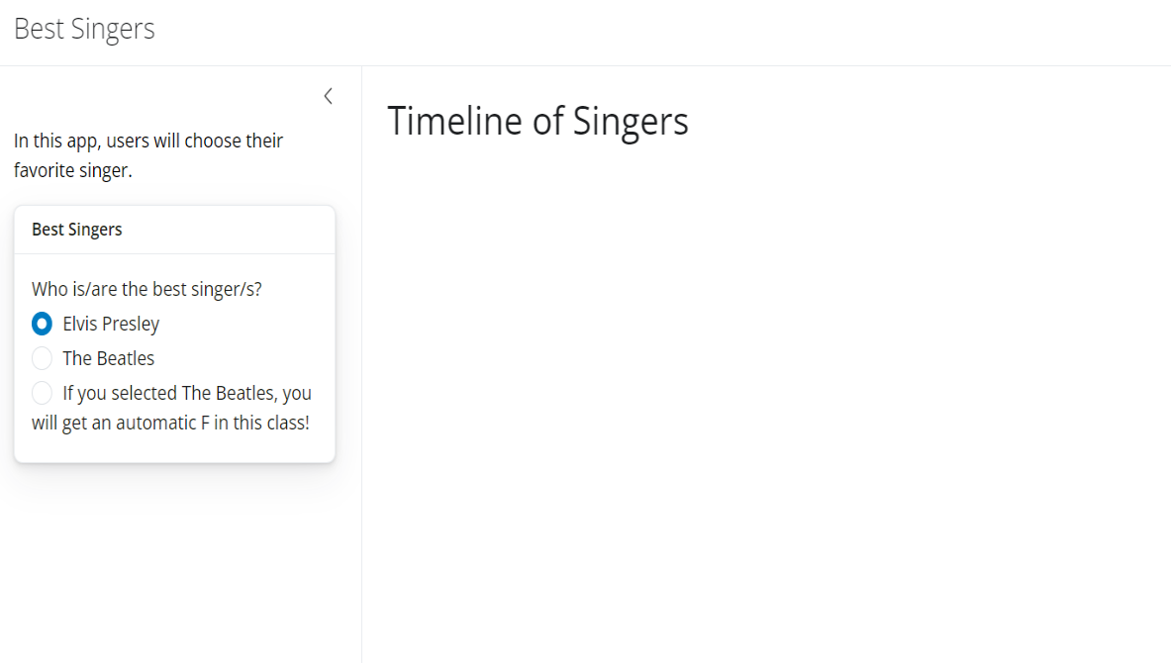
To Recreate 2
File Name: shiny_app_widget_radio_button

Slide 12
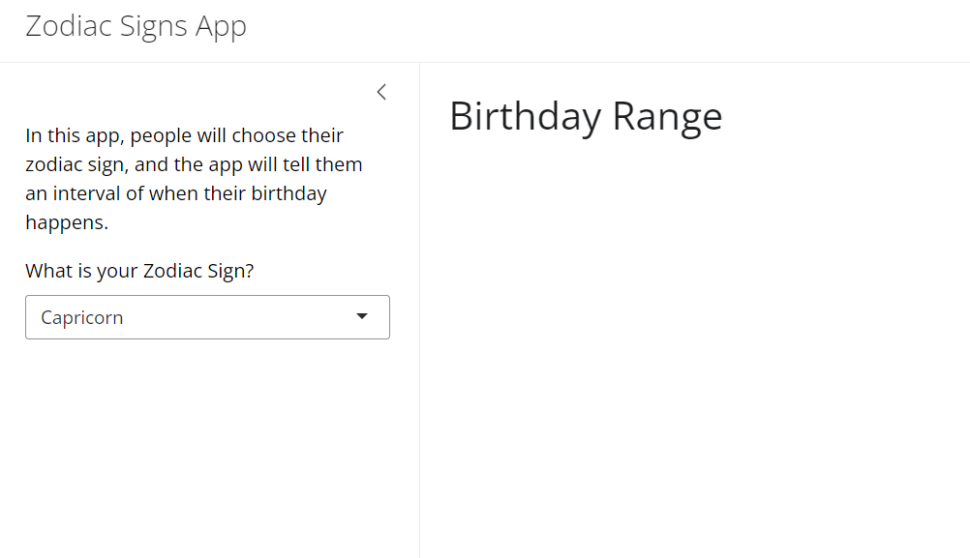
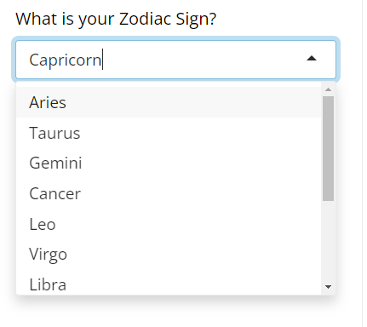
To Recreate 3
File Name: shiny_app_widget_select_box

Slide 13
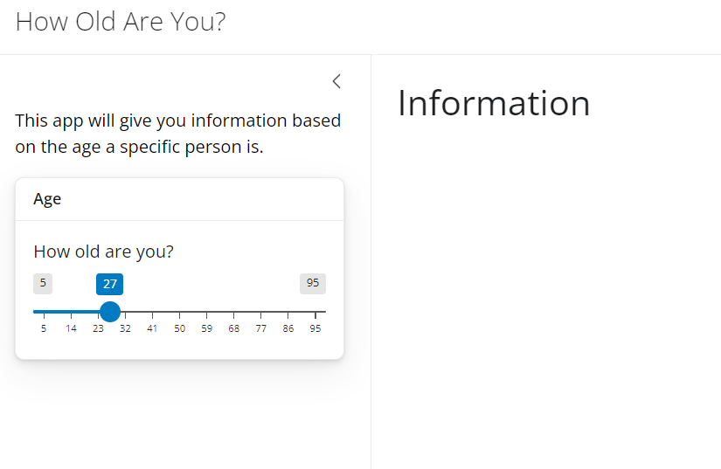
To Recreate 4
File Name: shiny_app_widget_slider

